Slide 2
Digital Forensics Lecture-9
By- Dr.subhranil Das
Assistant Professor
School of computer Science

Slide 3

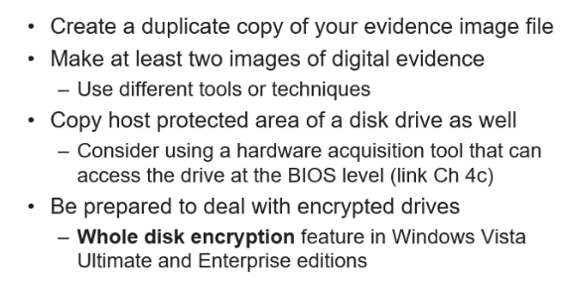
Planning for Image Acquisition

Slide 4
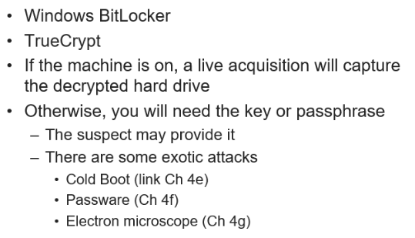
Encrypted Hard Drives

Slide 5
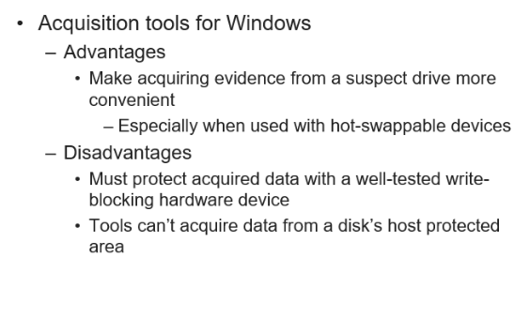
Acquisition Tools

Slide 6
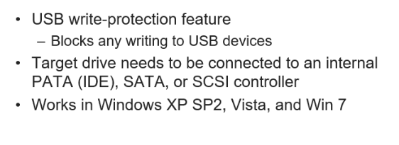
Windows Write Protection with USB drives

Slide 7
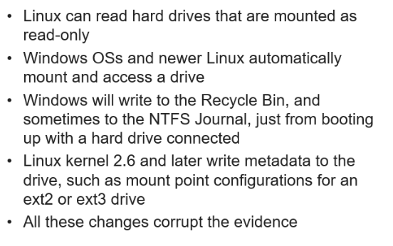
Acquiring Data with Linux Boot CD

Slide 8
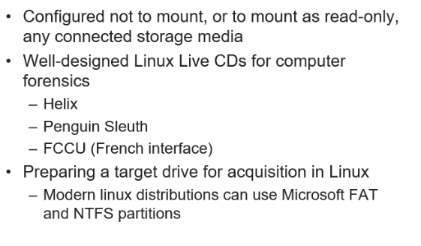
Forensic Linux Live CD

Slide 9
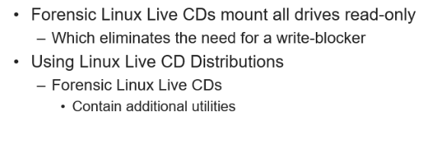
Acquiring Data with Linux Boot CD

Slide 10
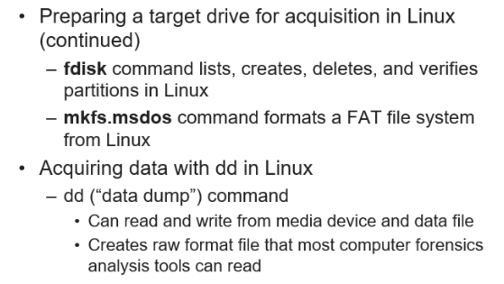
Acquiring Data with Linux Boot CD

Slide 11
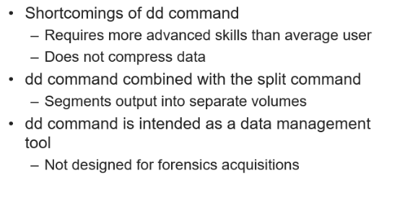
Acquiring data with dd in Linux

Slide 12
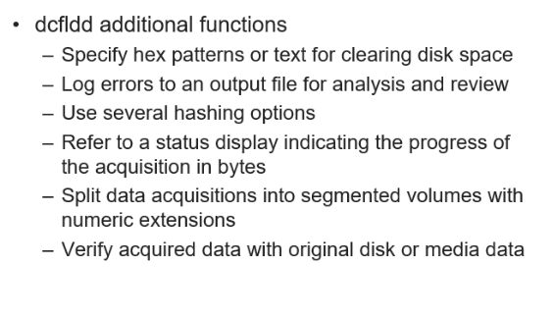
Acquiring data with dcfldd in Linux

Slide 13
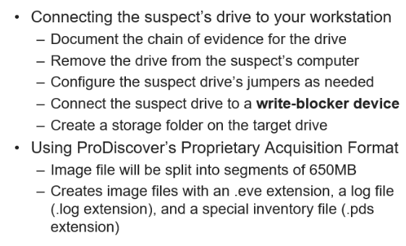
Capturing the image with ProDiscover Basic

Slide 14
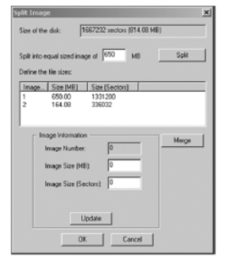
Split Image with Prodiscover Image

Slide 15
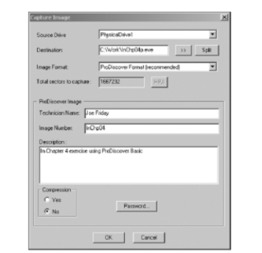
Capture Image Dialog Box

Slide 16
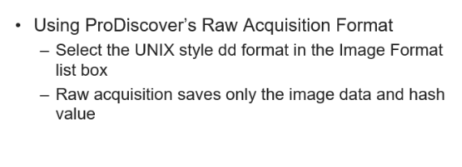
Capturing the image with ProDiscover Basic

Slide 17
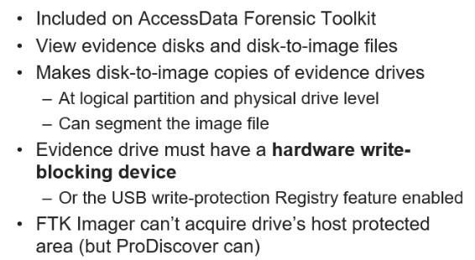
Capturing the image with Access Data FTK Imager

Slide 18
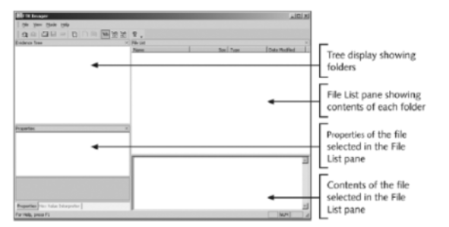
Capturing the image with Access Data FTK Imager

Slide 19
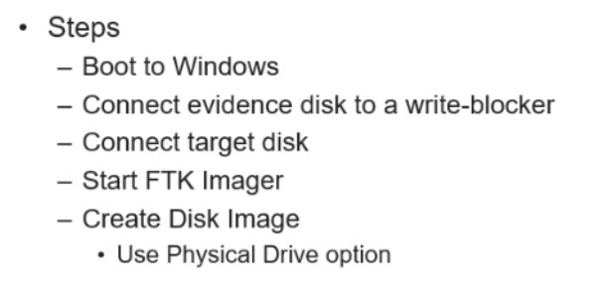
Capturing the image with Access Data FTK Imager

Slide 20
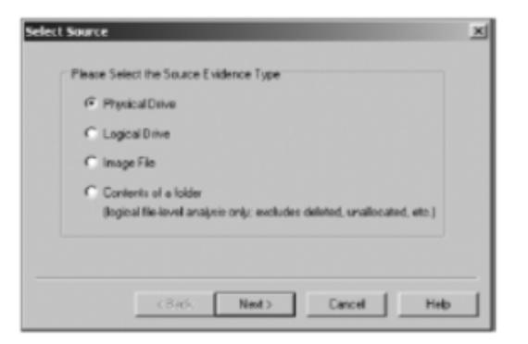
Source File Dialog Box

Slide 21
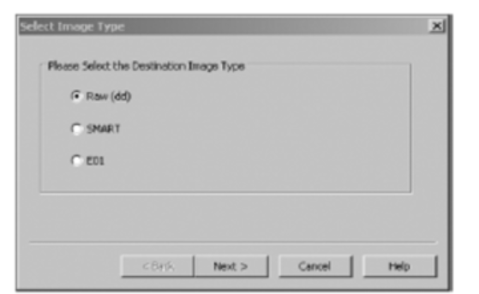
Destination Image Dialog Box

Slide 22
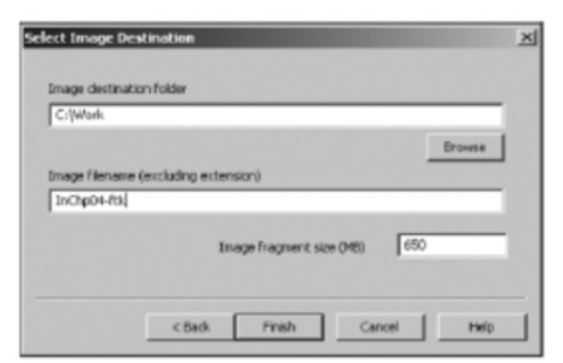
Select Image Destination

Slide 23
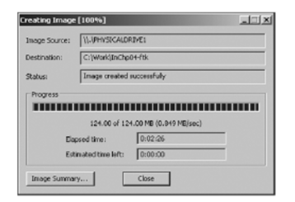
Complete Image Saving Process

Slide 24
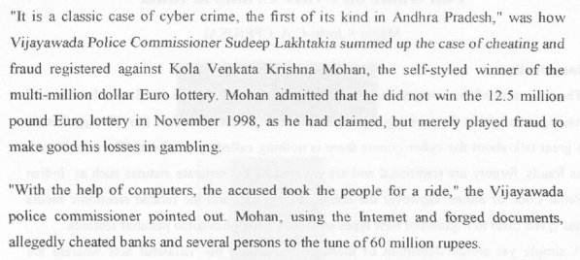
Case 6: Digital Crime Fraud

Slide 25
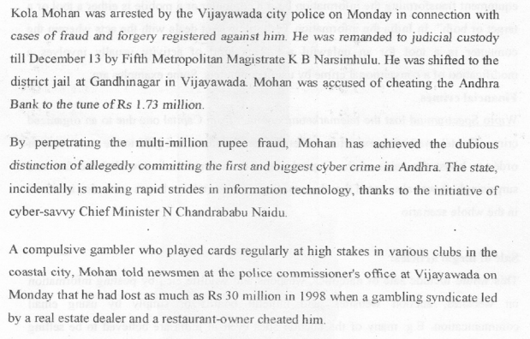
Case 6: Digital Crime Fraud

Slide 26
Next Lecture
Digital Evidence Acquisition

